Slide 1
SOMERSET PURPOSE
Somerset Academy, Inc. promotes a transformational culture that maximizes student achievement and the development of accountable, global learners in a safe and enriching environment that fosters high-quality education.
S - Set high expectations
O - Objective
M - Meaningful curriculum
E - Effective
R - Resourceful and responsible life long learners
S - Scholars who achieve proficiency and beyond
E - Evaluate continuously and use data to drive curriculum
T - Teachers who are highly qualified

Slide 2
DO NOT. . .
“Hang out” in the stairwells or on the second floor during lunch.
Chew gum. DO NOT BRING GUM!
Go on the basketball court with a skateboard!
Use the elevator without approval from the office.
Leave campus if you are a Middle Schooler, Freshman or Sophomore (Except for DE students)
Allow an underclassmen in your vehicle without prior permission, or you will lose all privileges for the remainder of the school year.
Throw anything off the balcony.
Throw anything from the ground level to the 2nd floor.
Eat or carry food over the basketball court or turf field
Litter or leave garbage around at lunch
Hang out by the wavy wall side or behind the basketball court bleachers
Hang on or grab the basketball nets/rims
Playing “keep away” = a detention
Yoga pants/ leggings/ are not allowed. Not even during dress down days. Dress code violations earn detentions
You are not to go to the Deans’ office during class to argue a detention. You will be turned away.

Slide 3
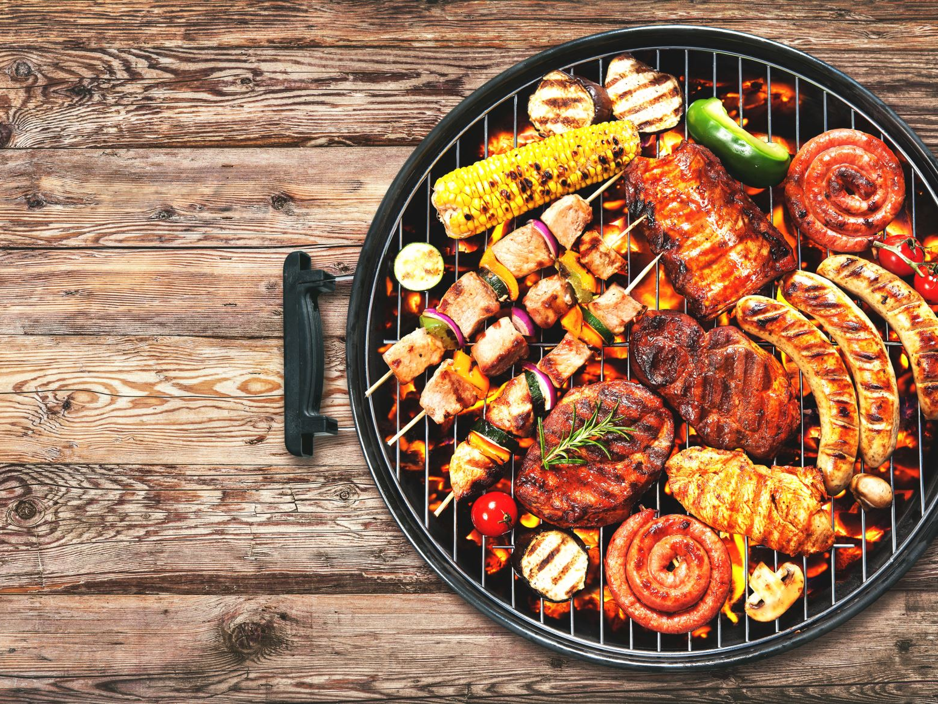
NO FOOD ON THE COURT

Slide 4
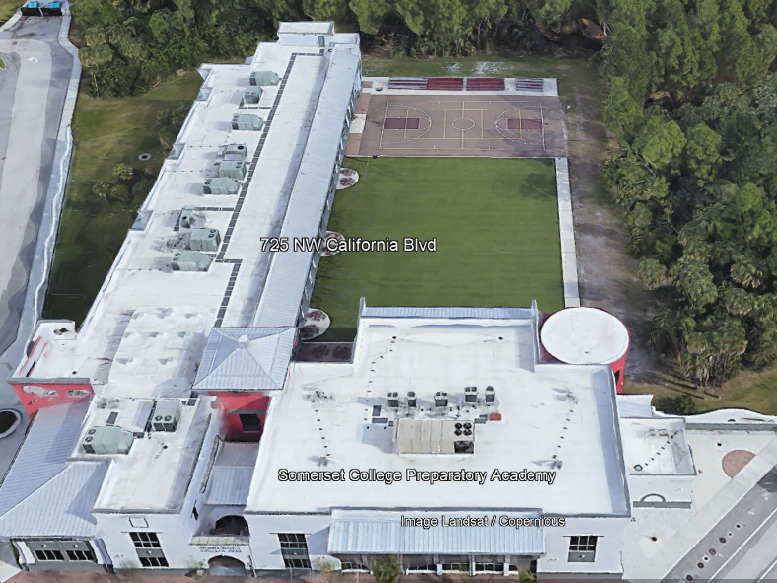
There is NO open food or liquid on the turf!!!
If you are caught, you will be having a meeting with the deans
TURF!

Slide 5
Tutoring Schedule
Mondays – ENGLISH (please see the schedule for which teach is staying for tutoring. The schedule is posted in all English teacher Classrooms)
Tuesdays – Math (ALL Math teachers)
Wednesdays – Social Studies
Thursdays – Science
Fridays – NONE
Need tutoring for electives? See your teacher to schedule.

Slide 7
Total of 18 Days of School in February
Warnings
344
Saturday
Detentions
80
Average of 19 Warnings issued
Per day for February
Electronic
Confiscation
59
Warnings 344
Uniform Violation
65
Class Disruption
64
Saturday
Detention
80
Electronic
Confiscation
59
Uniform
Violation
65
Class
Disruption
64
Tardy to
Class
30
Gum
18
Tardy to
Class 30
Chewing
Gum 18

Slide 9
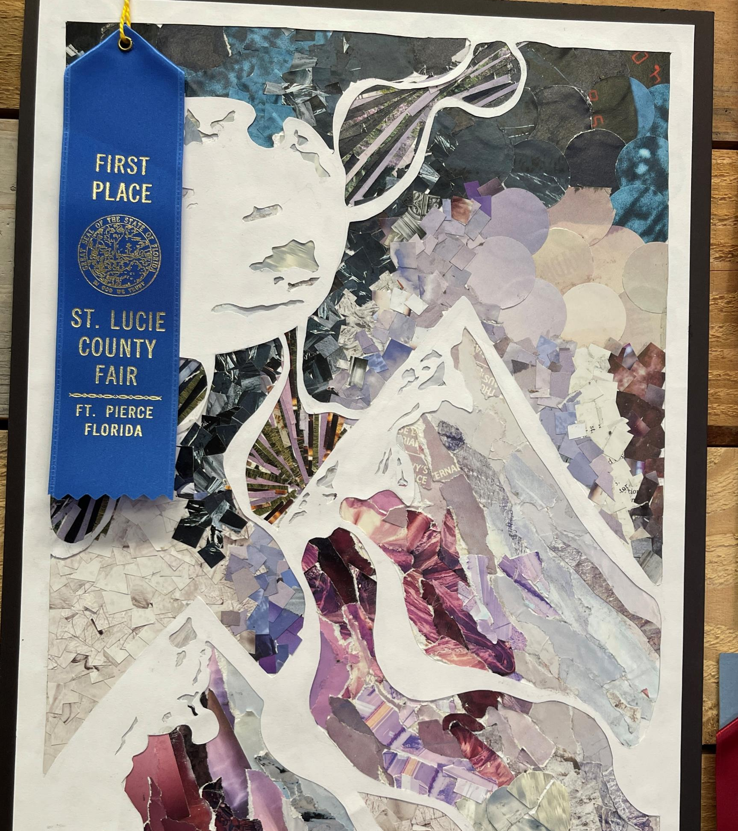
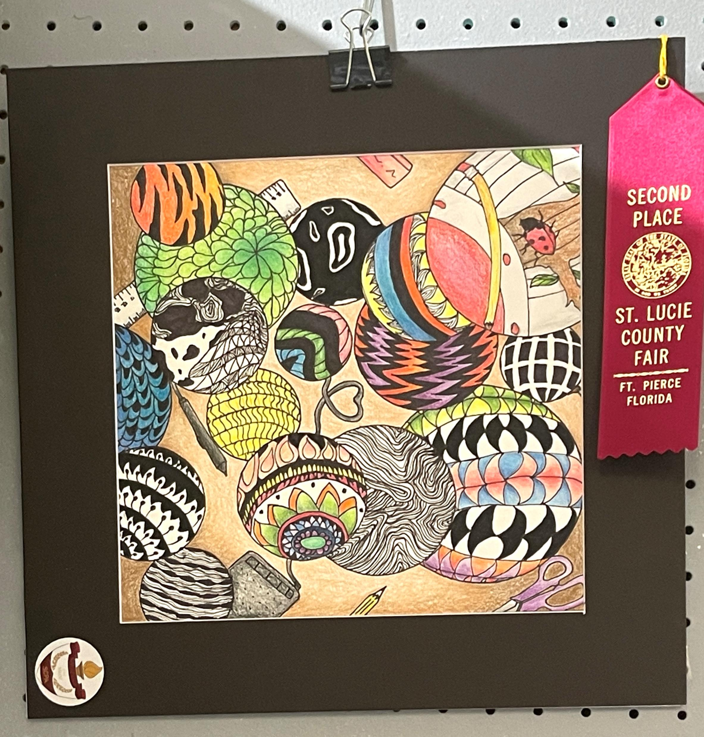
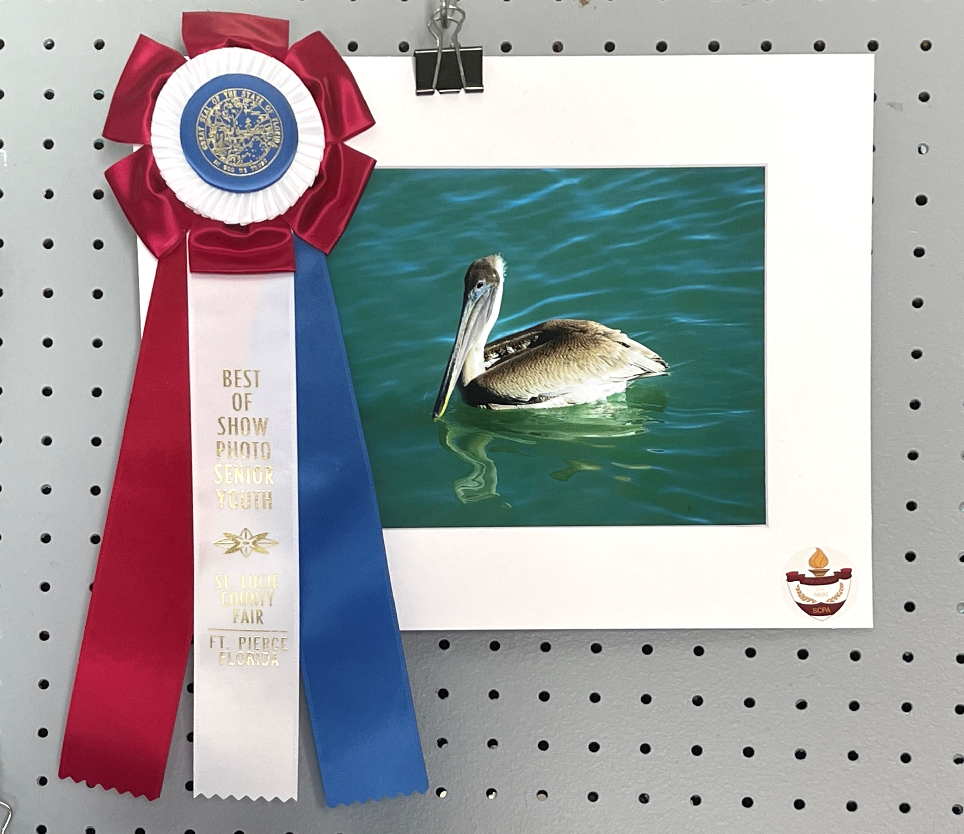
St. Lucie County Fair Award Winners in the Office Showcase CHECK IT OUT!

Slide 10
Attention Students
Do Not Spray any Body Sprays , Perfumes or Cologne's in the Restroom or Locker rooms. Anyone caught will receive a Detention

Slide 11
Dress Code Violations (Do Not Wear)
Non-Somerset Hoodies, Polos or Sweatshirts
Ripped or Frayed Jeans
Sweatpants, Joggers or Pajama Pants
Crocs or Slides

Slide 12
Discipline Matrix (Uniform Violation)
Warning
A warning issued by 1st period teacher or Staff. Email sent home via Concierge.
Tuesday & Thursday inside the cafeteria. Attendance will be taken; 30 minutes to eat lunch and 20 minutes to clean up inside and outside of cafeteria
Monday Detention
Monday Detention afterschool. 3:50pm to 4:50pm
Lunch Detention
Saturday Detention
Referral & Behavior Probation
Saturday Detention
9:30am to 12:30pm
Referral and 9-week behavior probation contract.
1st Offense
2nd Offense
3rd Offense
4th Offense
5th Offense

Slide 14
Donation Drive for SafeSpace Florida Help Gabriel Frey’s Eagle Scout Project
BSA Troop 448
Participate in Gabriel Frey’s donation drive to help SafeSpace Florida, which provides safe nights to people in need.
Drop your items (list on next slide) in your house’s box in the cafeteria! Money donations are not accepted.
House points will be awarded!
The last day for donations is March 9th.

Slide 15
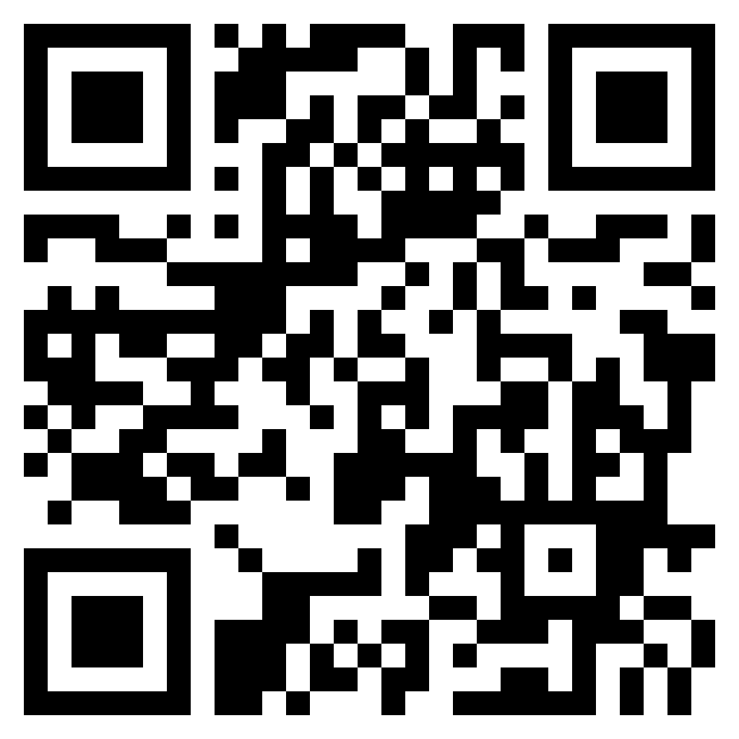
Donation Drive for SafeSpace Florida Help Gabriel Frey’s Eagle Scout Project
BSA Troop 448
Cleaning Supplies
Laundry supplies
Hand Soap
Cleaning agents (Bleach, Windex, Lysol, etc.)
Personal Items
Personal hygiene supplies
Feminine products
Hair/skin products
Bath/Linens
Shower curtains/rugs
Bathroom accessories
Towels/wash cloths
Pillows
Kitchen
Silverware
Pots/pans
Accessories (can openers, etc.)
These are only some of the items. The full list is available at https://safespacefl.org/wish-list/.
The list will also be sent out via text blast.

Slide 16
Annual Pop Tab Drive
March 27-March 31 starts SGA's annual pop tab drive!
Bring in all pop tabs to the cafeteria and drop them off in assigned house containers.
This is a House Competition and points will be awarded to the top three Houses.
Points will be determined by weight in lbs.
All pop tabs will be donated to the Ronald Mcdonald House Charites to provide housing and food for families of patients at Children's Hospital.

Slide 17
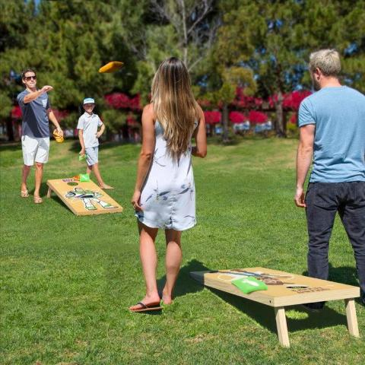
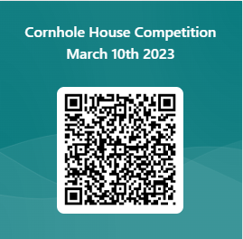
House Cornhole Competition
A House based Cornhole Competition will be featured at the March 10th House Wars
When it will happen:
March 6-7-8-9 there will be play in rounds.
The Play-In-Rounds will be made up for 8 students per house (Teams of 2 for each game)
Students can sign up as a pair or Individually
Based on Wins/Loses & points Houses will be ranked 1-5.
On the 10th there will be finals to determine points
#1 vs #2 (Determining 1st & 2nd Place)
#3 vs #4 (Winner places 3rd Overall)
#5 Automatically Eliminated
The Sign up will be open until 4PM on March 3rd.
If more than 8 people sign up per house students will be randomly selected from the Volunteers
SIGN UP USING THIS QR CODE→

Slide 18
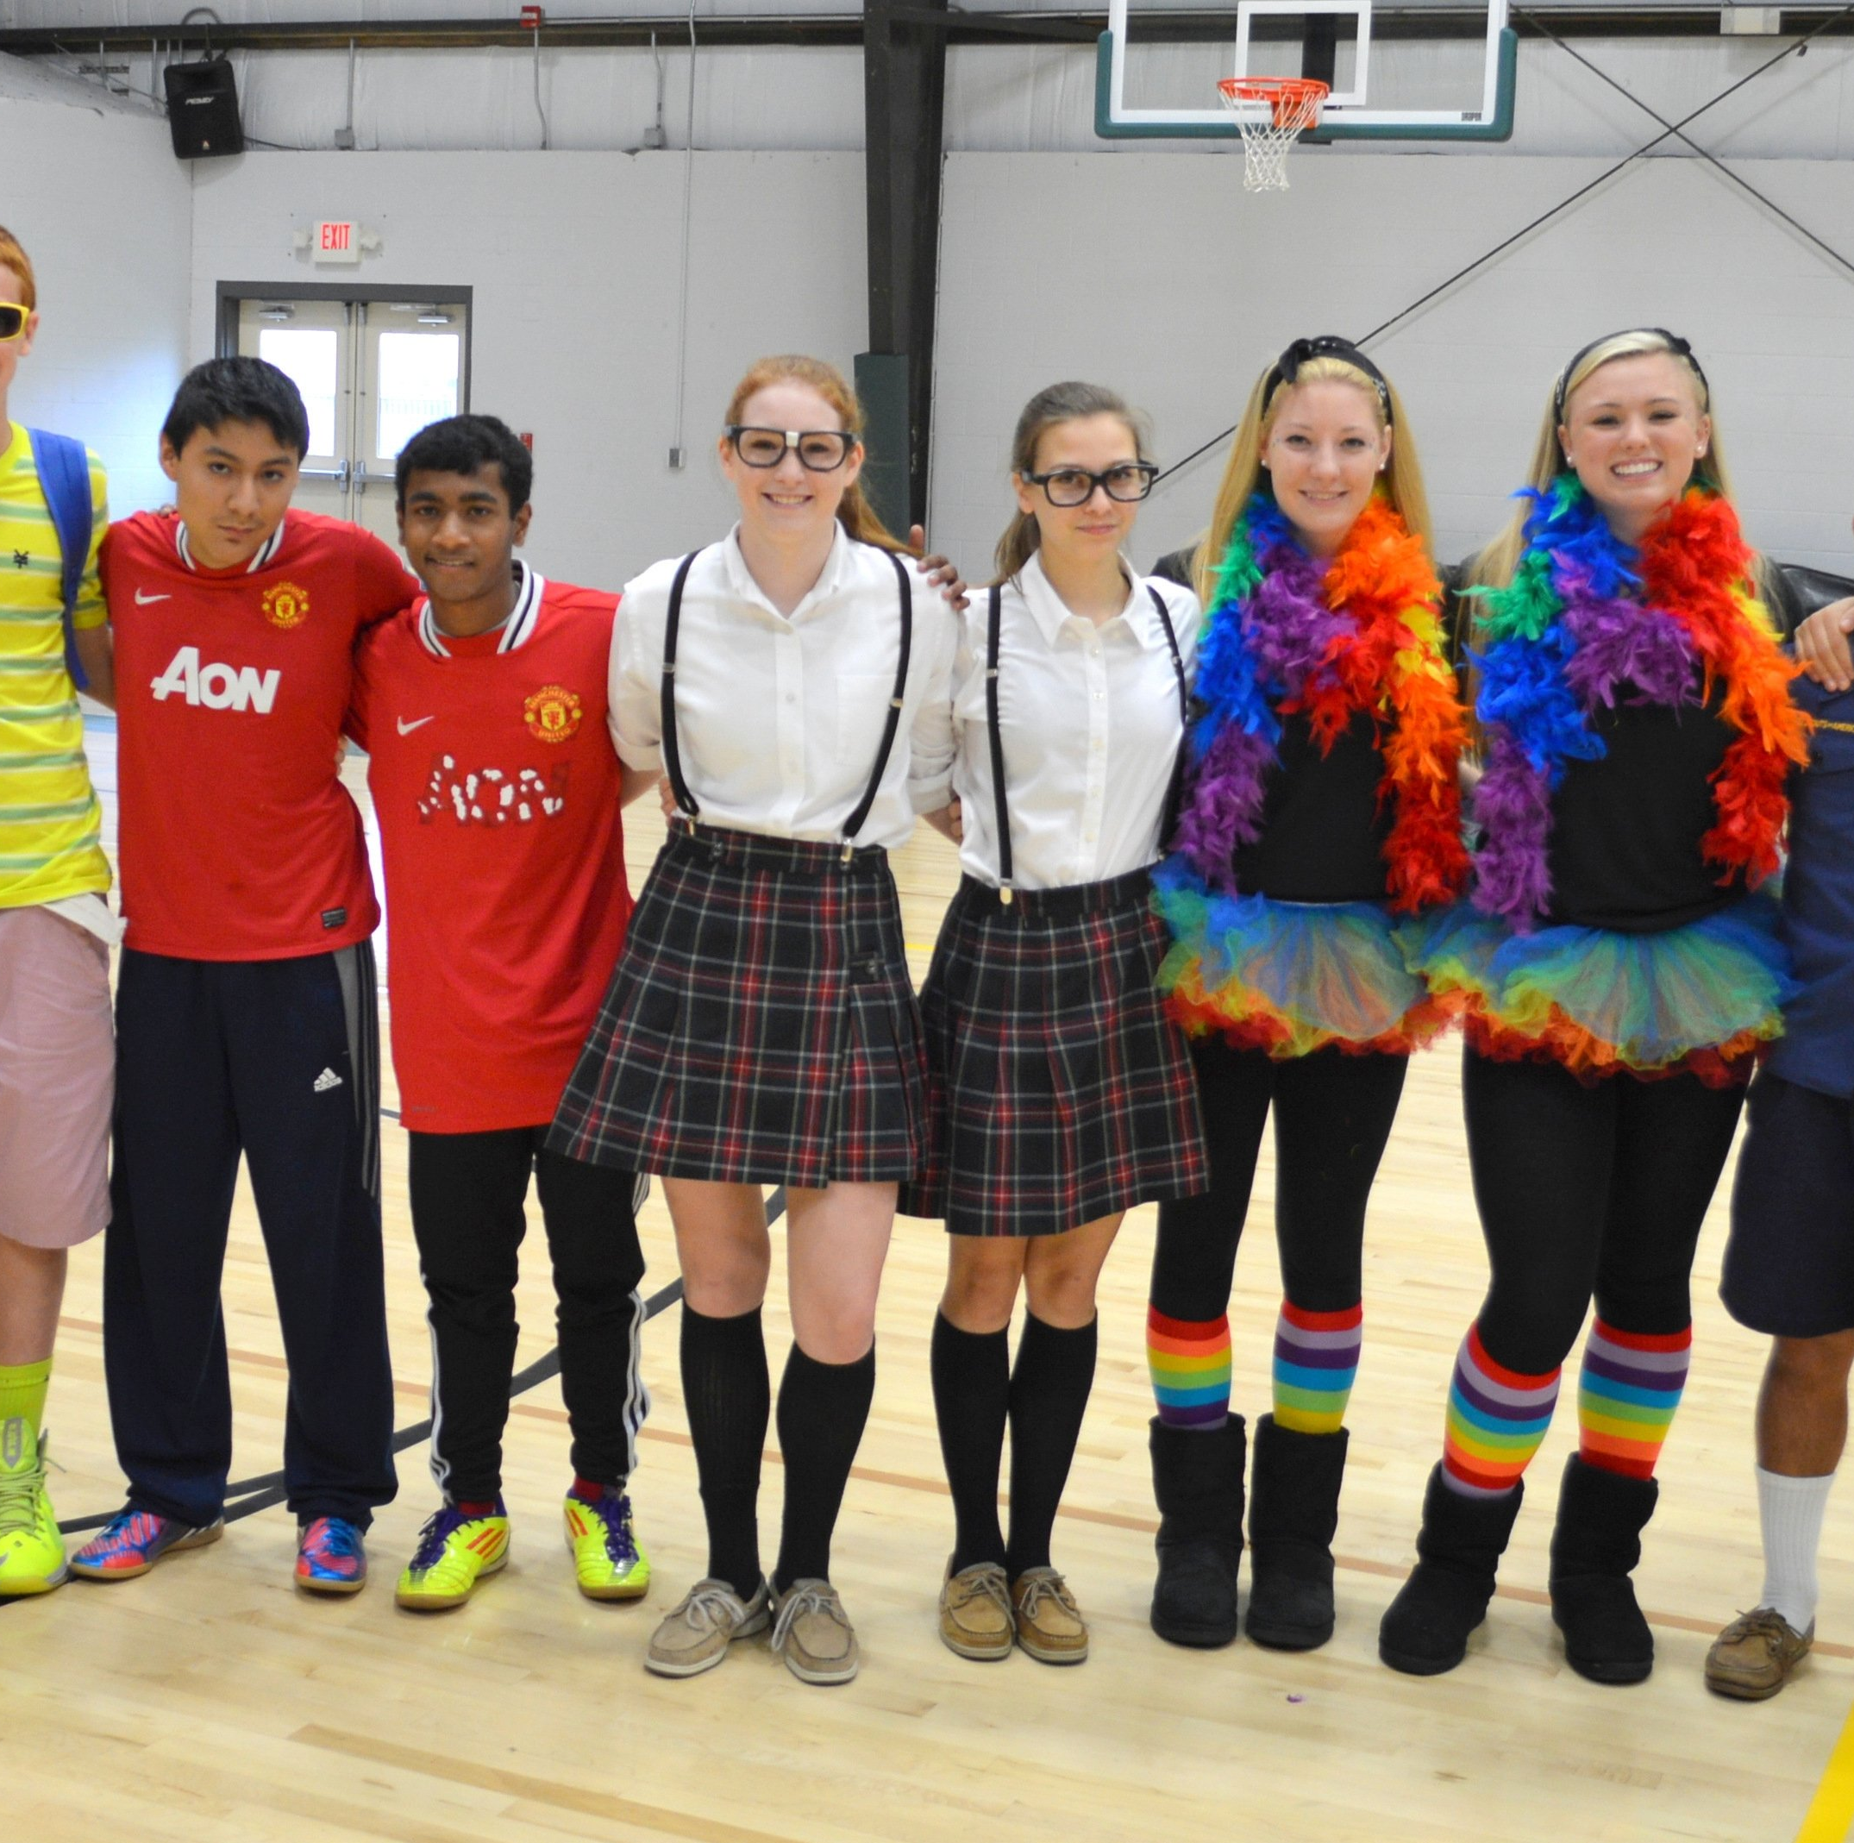
VERSUS WEEK: DUOS VS TRIOS. TUESDAY MARCH 7TH.
School-appropriate attire is required.
$2 per spirit day.
On Tuesday, a pairing of two or three people can dress up as a famous/icon duo or trio.
Detentions will be issued to outfits not considered school appropriate and if a dress down wristband is not purchased.
Bands can be purchased in the morning or during lunch.

Slide 19
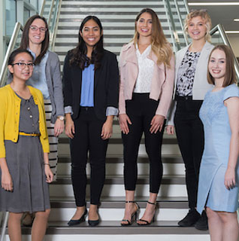
VERSUS WEEK: DRESS UP VS DRESS DOWN. WEDNESDAY MARCH 8TH.
School-appropriate attire is required.
$2 per spirit day.
On Wednesday, students can come in dressed fancy wearing smart outfits such as suits or dresses or dress down and come in causal wear.
Detentions will be issued to outfits not considered school appropriate and if a dress down wristband is not purchased.
Bands can be purchased in the morning or during lunch.

Slide 20
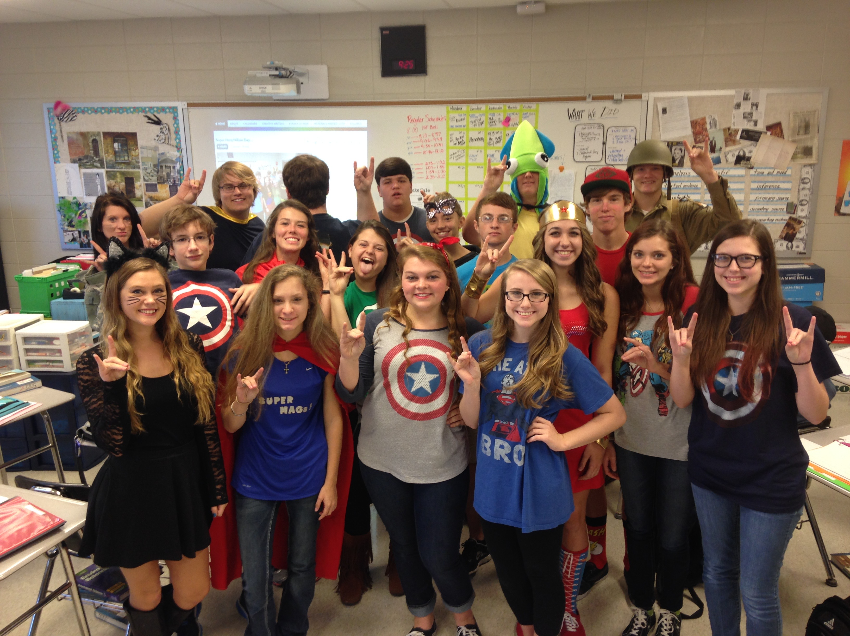
VERSUS WEEK: HEROS VS VILLANS. THURSDAY MARCH 9TH.
School-appropriate attire is required.
$2 per spirit day.
On Thursday, students can dress up as one of their favorite hero or villain in any story/comic/movie.
Detentions will be issued to outfits not considered school appropriate and if a dress down wristband is not purchased.
Bands can be purchased in the morning or during lunch.

Slide 22
Order your Crumbl
cookies via the app on THURSDAYS only
by following the video directions.
You CANNOT order any other day. Or the order will not be delivered.
DO NOT order the
ice cream.
Message SGA on insta a pic of you with your Crumbl box for a chance to be featured on our page! @scpa.sga

Slide 23
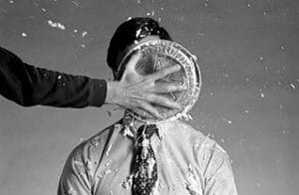
PIE YOUR TEACHER!! All proceeds go to the prom committee!
Enter as many votes as you like for your opportunity to pie your favorite or least favorite teacher the day before spring break.
See Mrs. Ruiz in the front office to purchase your voting tickets!
Teachers & Staff who are participating so far are as follow:
Mr. Matluck, Ms. Peggy, Mrs. Ruiz (front office), Mr. Rivera, Mrs. Bethel, Ms. Platt, Mr. Marsh, Ms. DeCesare, Ms. Brown, Ms. Harrel, Mr. Delacruz, Ms. Stratton, Ms. Wally, Ms. Devereux, Mr. Ludwig, and Ms. Douglas. With more teachers joining everyday!!

Slide 24
Work for the City of Port St. Lucie!

Slide 26
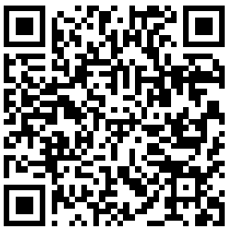
This year's Student Podcast Challenge will open for entries on Jan. 6, 2023 and close on April 28
https://www.npr.org/2022/12/14/1141665744/student-podcast-challenge-contest-npr-2023

Slide 27
TURF DURING LUNCH
Volleyball
Monday-Friday: NO SPIKING!!!
Basketball
Monday/Wednesday: Middle school only
Tuesday/Thursday: Highschool only
Rotate Fridays

Slide 28
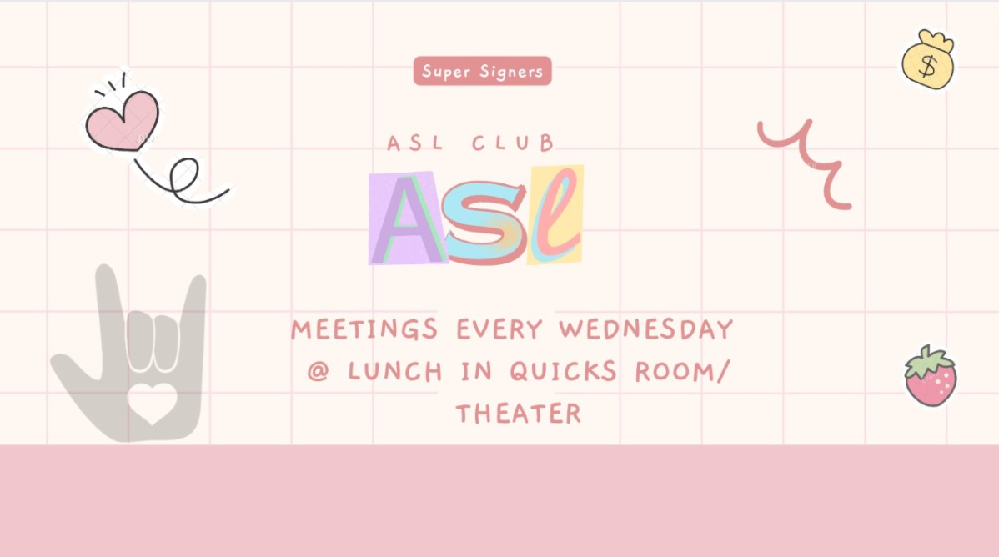

Slide 29
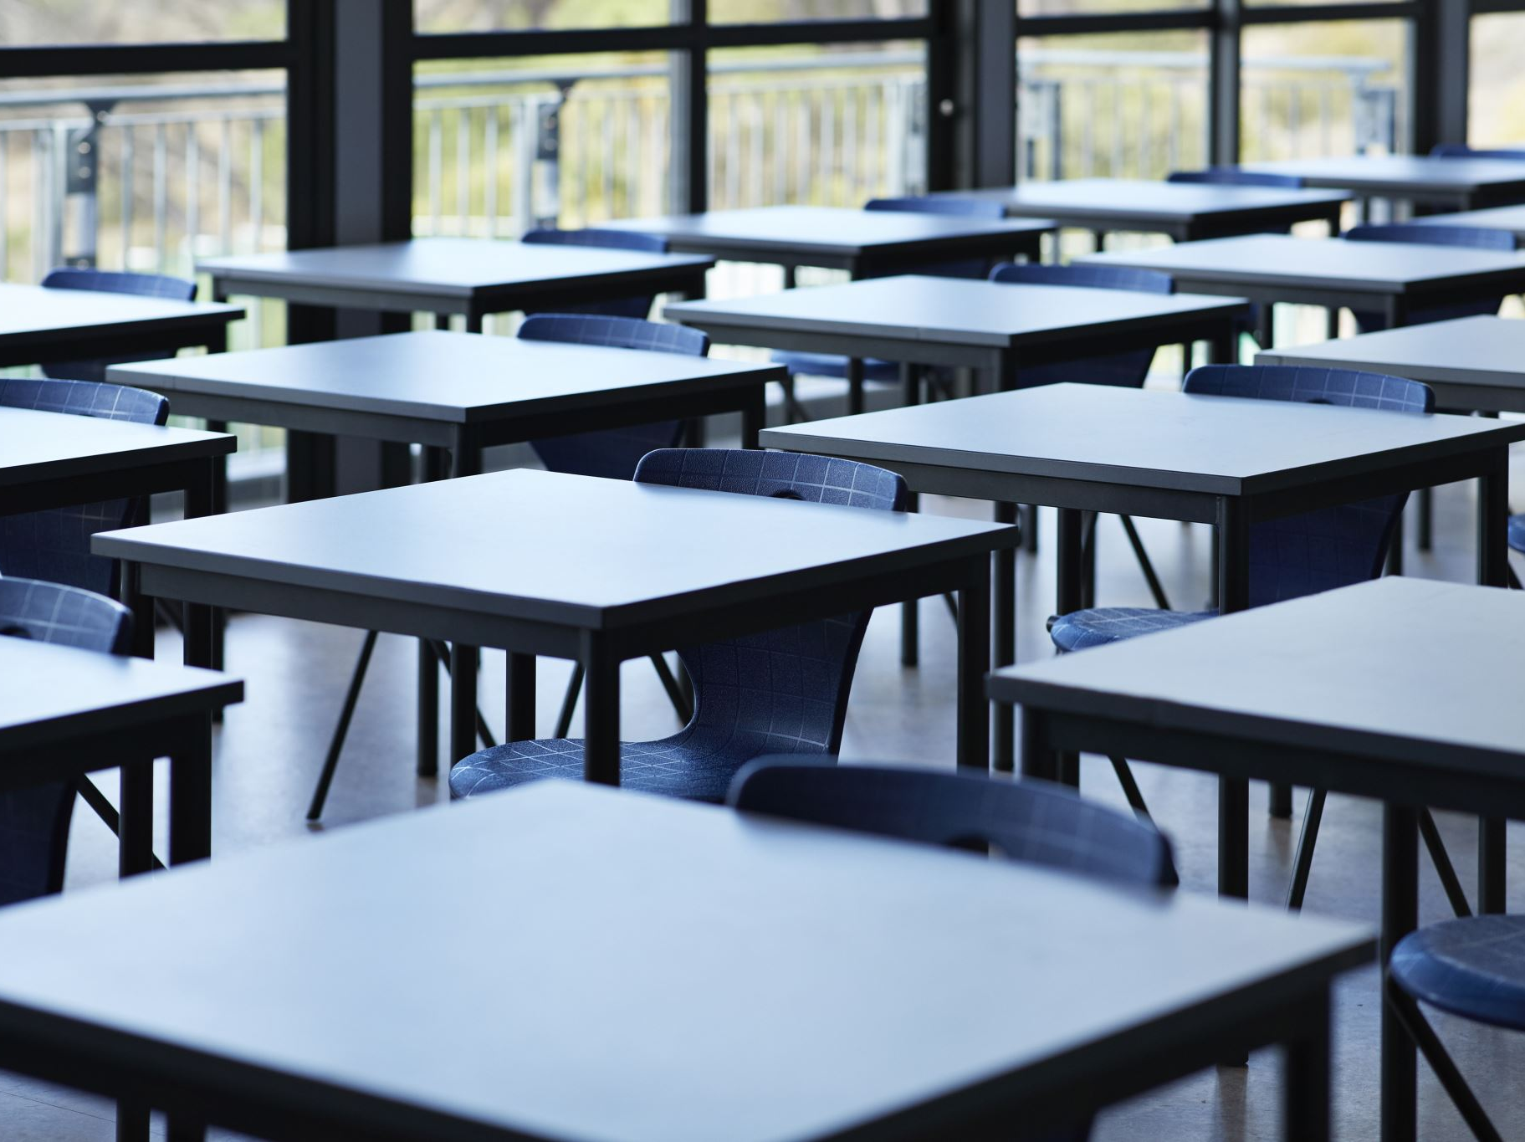
Clubs
Chorus Club for high school on Mondays, after school, in 268
D & D, Mondays, after school, in 175
Mock Trial in 263, on Mondays and Tuesdays during lunch.
Salsa Dancing in 136, on Tuesdays and Thursdays at lunch.
SGA, every other Wednesday, after school, from 3:45-5 in room 222
GSA on Wednesdays in 169 at lunch 11:55am-12:30pm
ASL on Wednesdays in the theater room, at 12pm on lunch.
Chorus Club for middle school on Thursdays, after school, in 268
Chess Club- Thursday at lunch, in 232
Senior Committee Meeting, Thursdays, after school, in 136

Slide 30
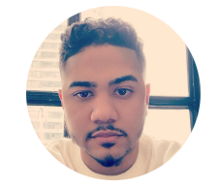

Slide 31
House Reminds
For anyone who needs the house remind this year ☺ This is important for communication with your house head.
Ares-@houseare
Athena-@scpaathena
Hestia- @househes
Poseidon- @psdnscpa
Zeus-@housezeus

Slide 32
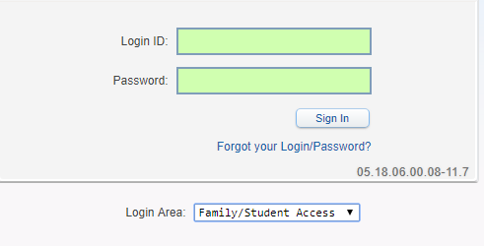
Student Skyward Access
Login ID: (Student 562#)
Password: (8 Digit Birthdate - MMDDYYYY)
Example: 08032005
**You May access Skyward through the school’s website.

